Slide 1



Module 2: Classes and Objects, methods and constructors

Slide 2
Outline
First Java Program - structure explained
The Object Model, Elements of the Object Model (Features)
What is Class
Classes and Objects
Data Types in Java
Typecasting
Key Abstractions and Mechanisms
3

Slide 3
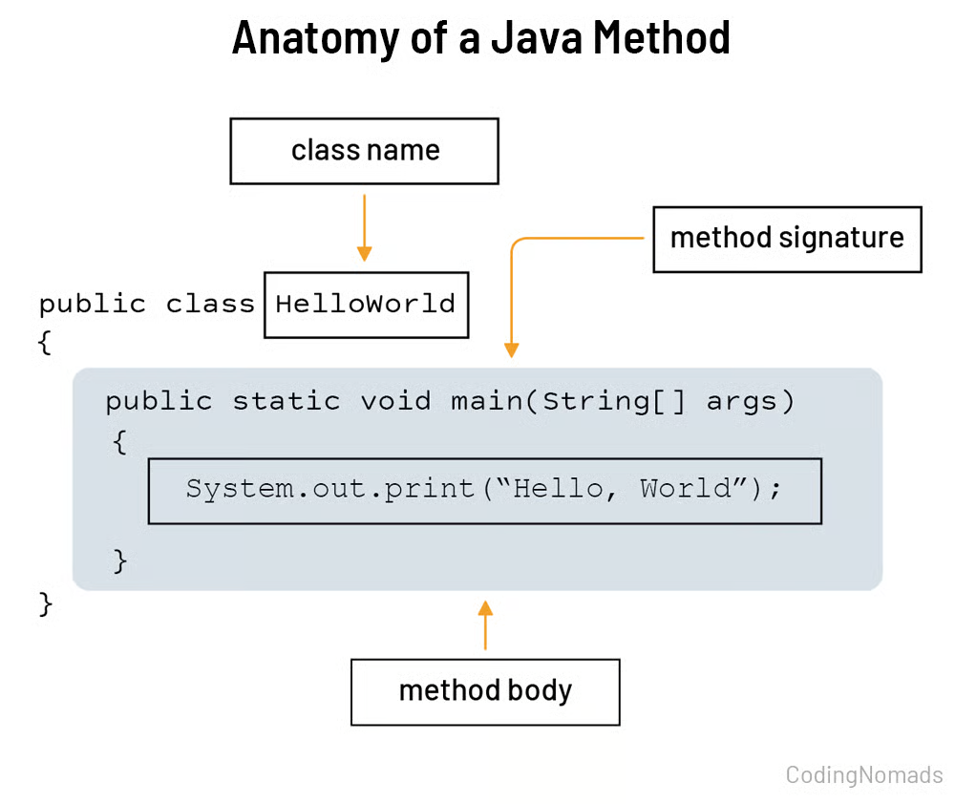
First Java Program

Slide 4
First Java Program
class Hello
Every Java program must be inside a class
Hello is the class name
File name should be: Hello.java
Java is class-based, so no code exists outside a class
2. { } — Class body
Curly braces define the scope of the class
Everything related to the class is written inside
3. public static void main(String[] args)
This is the entry point of a Java program

Slide 5
First Java Program
4. System.out.println("Hello World");
Prints output on the screen
System → predefined class
out → output stream object
println() → method to print text and move to next line

Slide 6
First Java Program
Keyword | Meaning
public | JVM can access it from anywhere
static | No object is required to call main fxn
void | Returns nothing
main | JVM looks for this method (entry point)
String[] args | Command-line arguments

Slide 7
The computer does not understand our human languages and it only understands codes that are in binary or coded form that means 0 or 1.

Slide 8
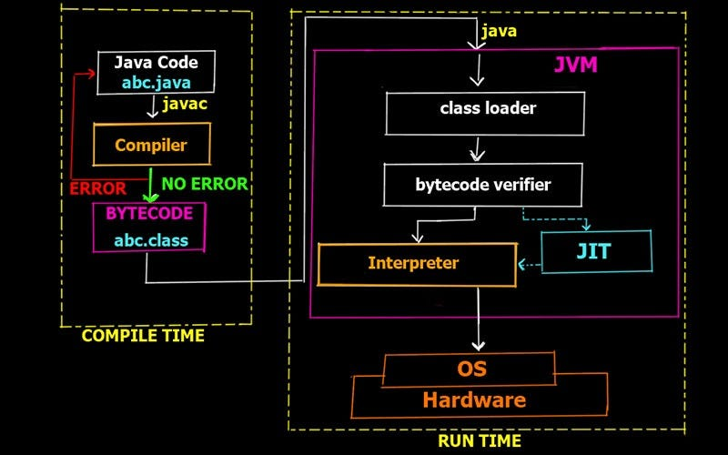
How Java Program runs

Slide 9
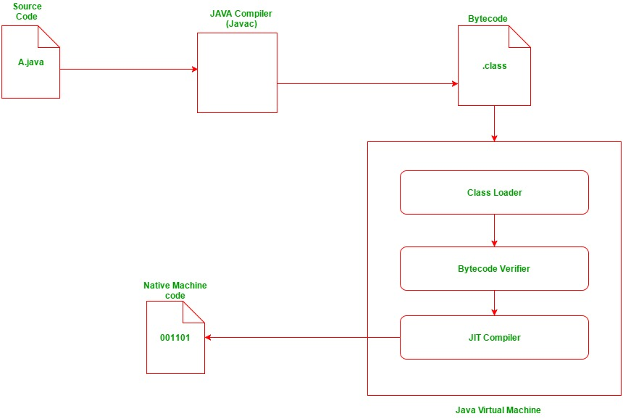
How Java Program runs

Slide 10
First Java Program
Compiler compiles the source code which in turn gives out the java bytecode and that needs to have a program.class extension.
This bytecode can be run anywhere irrespective of the machine on which it has been built - Platform Independence
Java Virtual Machine which is an interpreter reads all the statements thoroughly step by step from the java bytecode, and converts it into machine-level language so that the machine can execute the code.
Notes:
Do a right click on .class file and show students how it opens and is in non-readable language- that is bytecode

Slide 11
What is JIT (Just In Time Compiler)
Initial Phase: When a Java program starts, the interpreter initially executes the bytecode line by line. This allows for a quick application startup time.
Optimization Phase: As the program runs, the JVM monitors the code for frequently used methods or loops (hot code)
JIT Compilation: The JIT compiler then compiles these "hot spots" into optimized native machine code. Subsequent calls to these sections bypass the interpreter and run the much faster native code.
This native code is stored in memory/cache for faster execution

Slide 12
2. The Object Model
Why Objects ?
Algorithms + Data structures = Programs
Traditional system development methodology focuses on the “Functions”
Object oriented system development focuses on the “Object” which combines “Data and Functionality”.
In an object-oriented system, everything is an object: numbers, arrays, records, fields, files, forms, an invoice, etc.
An Object is anything, real or abstract, about which we store data and those methods that manipulate the data.
3
Notes:
Hi

Slide 13
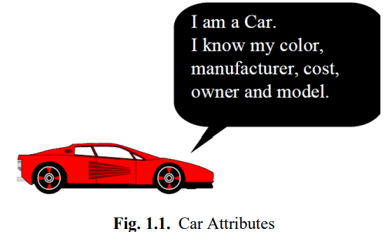
2. The Object Model
What is an Object ?
Object: It is a real-world entity that has properties and methods. E.g., Car.
Properties (or Attributes): It describes the state (or data) of an object. E.g., Color, manufacturer, cost, model and owner etc.
3
Notes:
Hi

Slide 14
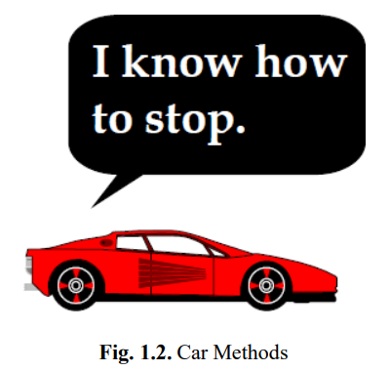
2. The Object Model
What is an Object ?
Methods (or Procedures): Methods defines behavior (or operations) of objects. E.g., Go, stop, turn left, turn right and etc.…
3
Notes:
Hi

Slide 15
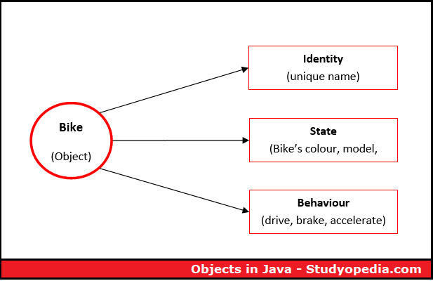
2. The Object Model
3
Notes:
Hi

Slide 16
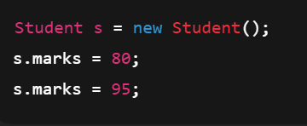
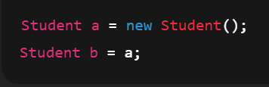
2. The Object Model
“The identity of object never changes even if all the properties of the object change; it is independent of the object’s state. The identity does not depend on the object’s name, or its key, or its location.”
3
Notes:
in first example,, we change value of a property,, or we change the state,, but this doesn’t change the object
in 2nd example a and b are simply two names, but they refer to the same object,,identity of the object does’t change

Slide 17
3. Classes
What are Classes
Objects are grouped into classes.
Classes are used to distinguish one type of objects from another
A class is a set of objects that share a common structure and a common behavior
3
Notes:
Hi

Slide 18
3. Classes
What are Classes
A class is a specification of,
Structure (instance variable): Structure of a class describes what data an object of that class will contain.
In Java terms: Structure = instance variables (also called fields / data members)
Behaviour (methods): describes the actions an object can perform.
3
Notes:
Hi

Slide 19
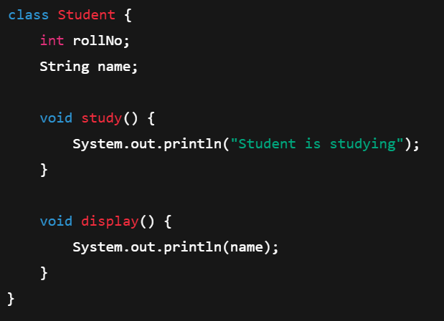
instance variable/ field/ data member
method

Slide 20
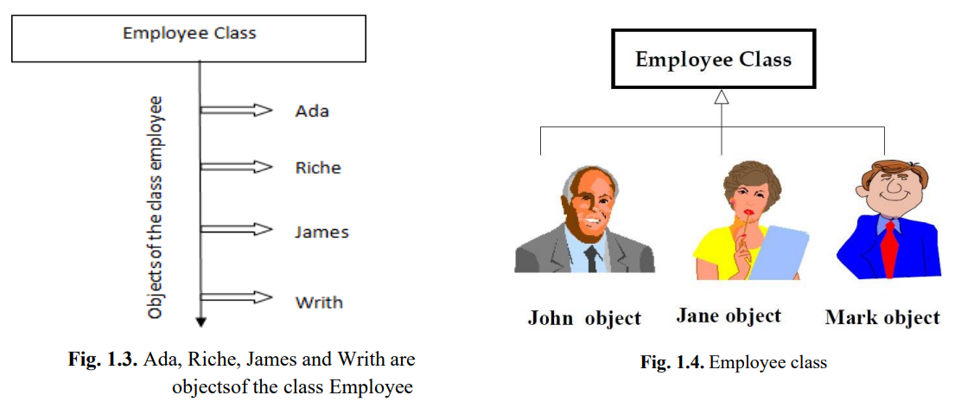
3. Classes
Classes:
3
Notes:
Hi

Slide 21
4. Classes and Objects
Car
Cost Color Make Model
Drive Break Maintenance
Object
Properties/ Field/ Data Members
Functions
3
Notes:
Hi

Slide 22
4. Classes and Objects
Class- Vehicle
Car1
Cost Color Make Model
Drive Break Maintenance
Car2
Cost Color Make Model
Drive Break Maintenance
Object
Properties/ Field/ Data Members
Functions
3
Notes:
Hi

Slide 23
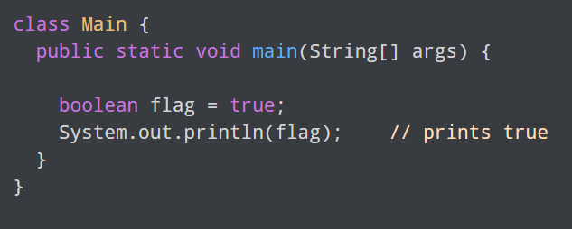
5. Java Data Types
1. boolean type
The boolean data type has two possible values, either true or false.
Default value: false.
They are usually used for true/false conditions.

Slide 24
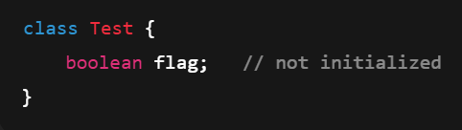

5. Java Data Types
1. boolean type
Java automatically does:

Slide 25
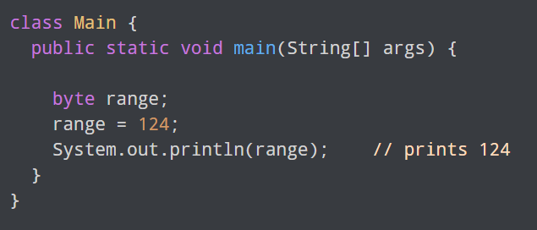
Java Data Types
2. byte type
The byte data type can have values from -128 to 127
If it's certain that the value of a variable will be within -128 to 127, then it is used instead of int to save memory.
8 bits are used to store byte type value in menory
Default value: 0

Slide 26
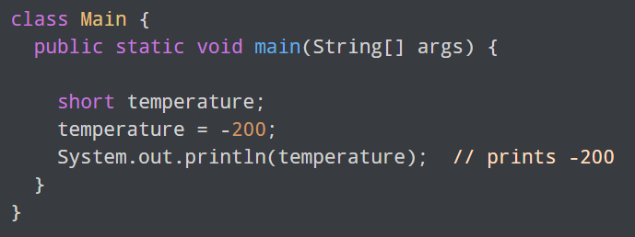
Java Data Types
3. short type
The short data type in Java can have values from -32768 to 32767 (16-bit signed two's complement integer).
If it's certain that the value of a variable will be within -32768 and 32767, then it is used instead of other integer data types (int, long).
Default value: 0

Slide 27
Java Data Types
4. int type
The int data type can have values from -2³¹ to 2³¹-1
Default value: 0
4 bytes (32 bits) used to store int type value in memory

Slide 28
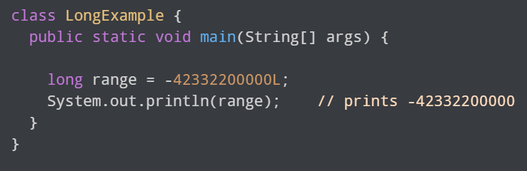
Java Data Types
5. long type
The long data type can have values from -263 to 263-1 (64-bit signed two's complement integer).

Slide 29
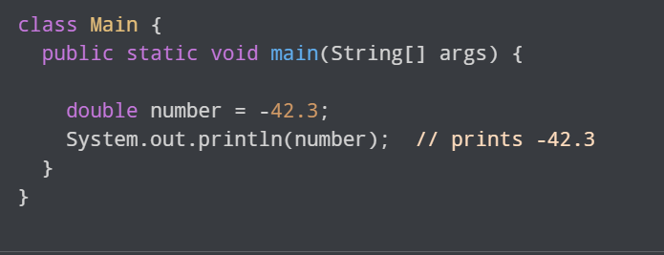
Java Data Types
6. double type
The double data type is a double-precision 64-bit floating-point.

Slide 30
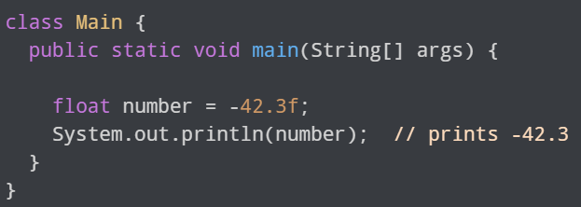
Java Data Types
7. float type
The float data type is a single-precision 32-bit floating-point. It should never be used for precise values such as currency.

Slide 31
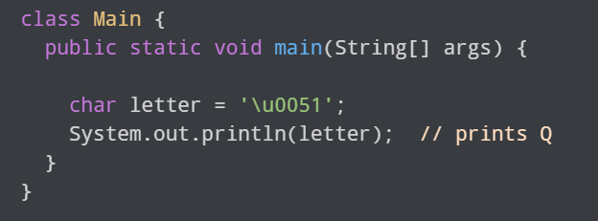
Java Data Types
8. char type
It's a 16-bit Unicode character.
The minimum value of the char data type is '\u0000' (0) and the maximum value of the is '\uffff'.
Default value: '\u0000'
Notes:
After \u there are four hex values. min value is 0 , max is 65536

Slide 32
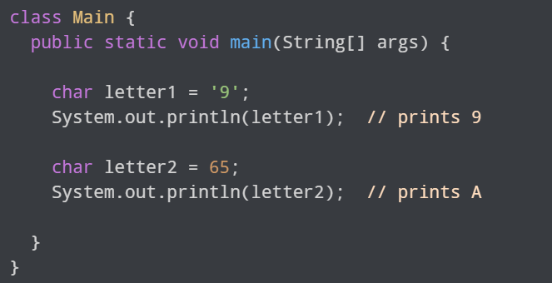
Java Data Types
8. char type
In ASCII (American Standard Code for Information Interchange), the decimal number 65 corresponds to the uppercase letter 'A'.
Notes:
65 is ASCII value of A

Slide 33
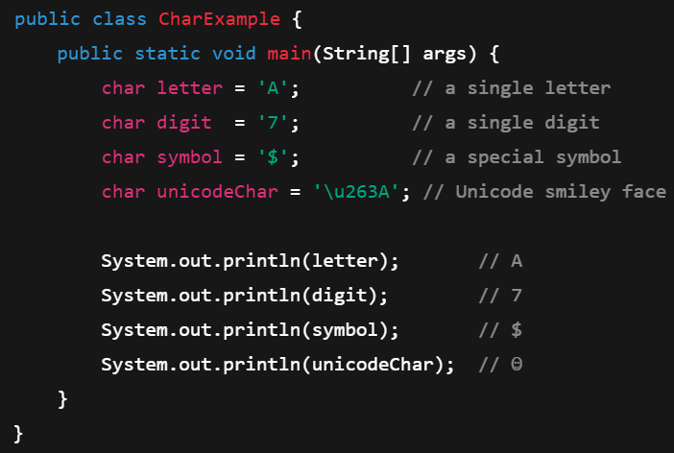
Java Data Types
8. char type
Notes:
65 is ASCII value of A

Slide 34

Java Data Types
9. String
Java also provides support for character strings via java.lang.String class. Strings in Java are not primitive types. Instead, they are objects. For example,

Slide 35


Java Data Types
Only one "Java" object is created
Both s1 and s2 point to the same memory location
This saves memory
Java stores strings in a special memory area called the String Constant Pool (SCP).
Stored in Heap memory*
Creates a new object every time
* Heap memory is a large pool of RAM used for dynamic memory allocation, allowing programs to request and release memory blocks at runtime for objects whose size isn't known beforehand.

Slide 36
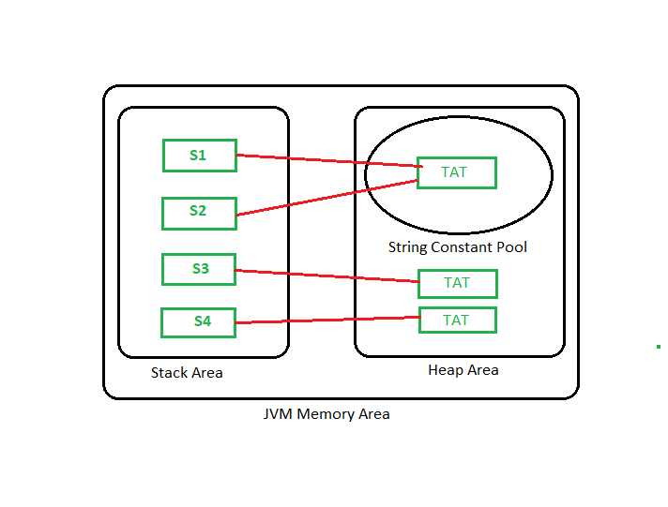
Java Data Types
Object created without ‘new’ keyword
Object created with ‘new’ keyword

Slide 37
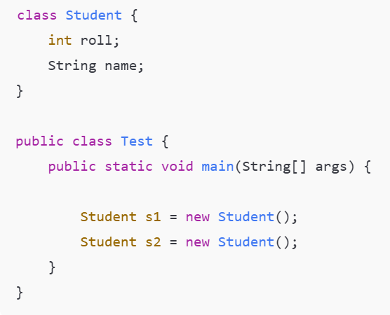
6. How Memory Allocation Happens

Slide 38
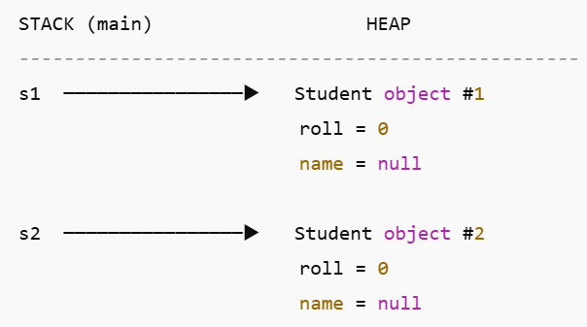
How Memory Allocation Happens
s1 has address of object 1
s2 refers to object 2

Slide 39
6. Java Access Modifiers
Access Modifier | Keyword | Accessible from
Public | public | Everywhere
Protected | protected | Same package + subclasses
Default | (no keyword) | Same package only
Private | private | Same class only

Slide 40
Example
Create a Java program to model a Car. The program should:
Represent the car’s attributes (members) such as color and speed.
Provide behaviors (methods) like accelerate() to increase speed and displayState() to show the car’s current color and speed.
Demonstrate the state of the car by storing and updating its color and speed.
Show how a Car object is created in memory and accessed through a reference variable.
https://onlinegdb.com/wafsNt-ZyA

Slide 41
7. Java Typecasting
Type casting means converting one data type into another. For example, turning an int into a double.
In Java, there are two main types of casting:
Widening Casting (automatic) - converting a smaller type to a larger type size byte -> short -> char -> int -> long -> float -> double
Narrowing Casting (manual) - converting a larger type to a smaller type size double -> float -> long -> int -> char -> short -> byte

Slide 42
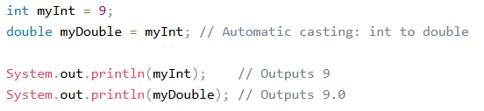
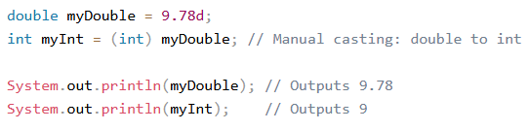
Java Typecasting Examples
When you "manually cast" a double to an int in Java, the number is not rounded in the mathematical sense; instead, it is truncated (the decimal portion is simply discarded, or rounded towards zero).

Slide 43
8. Java Method
A method is a block of code that performs a specific task.
Dividing a complex problem into smaller chunks makes your program easy to understand and reusable.
In Java, there are two types of methods:
User-defined Methods: We can create our own method based on our requirements.
Standard Library Methods: These are built-in methods in Java that are available to use.

Slide 44
Java Method
Run SumMain.java
https://onlinegdb.com/7EPl2n6li
Run SumMain2java
https://onlinegdb.com/WoPvXFJow

Slide 45
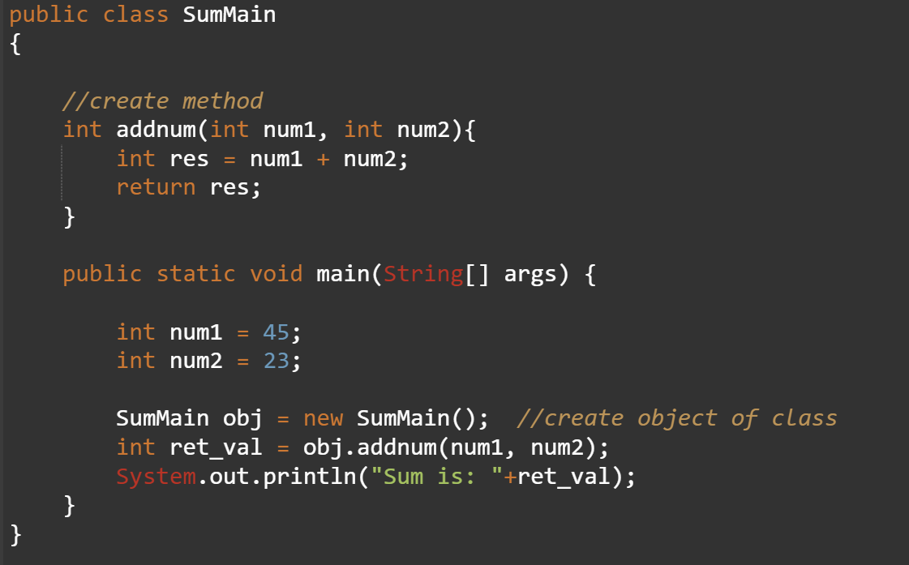

Java Method
SumMain.java
Output

Slide 46
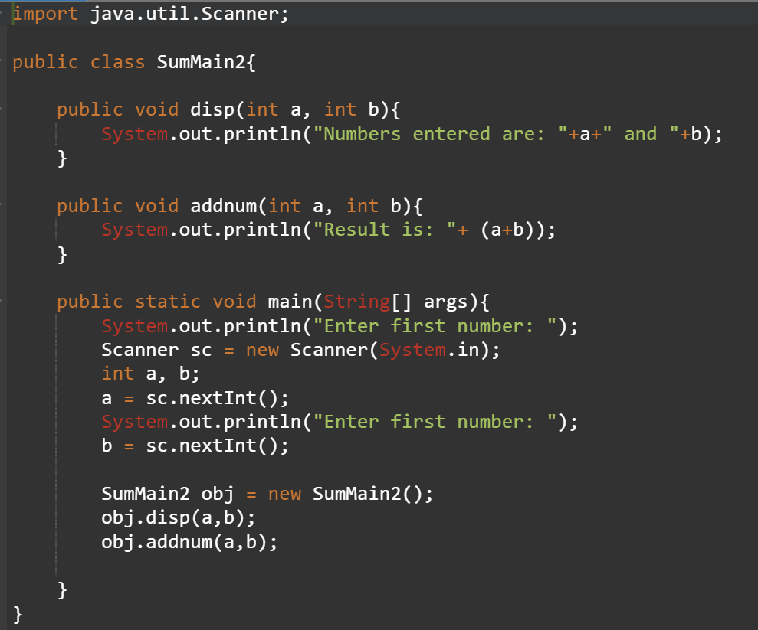
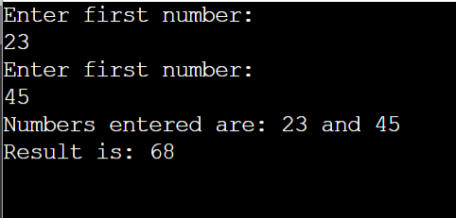
Java Method
SumMain2.java
Output

Slide 47
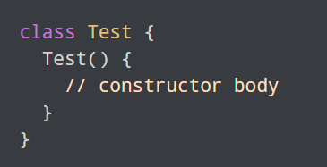
8. Constructor
A constructor in Java is similar to a method that is invoked when an object of the class is created.
Unlike Java methods, a constructor has the same name as that of the class and does not have any return type.

Slide 48
Types of Constructor
Constructors can be divided into three types:
No-Arg Constructor
Parameterized Constructor
Default Constructor

Slide 49
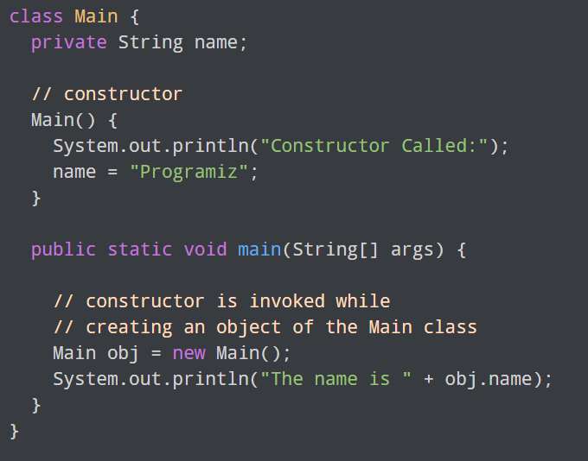
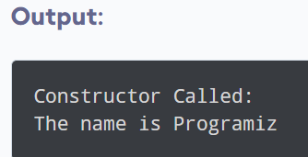
8. Constructor

Slide 50
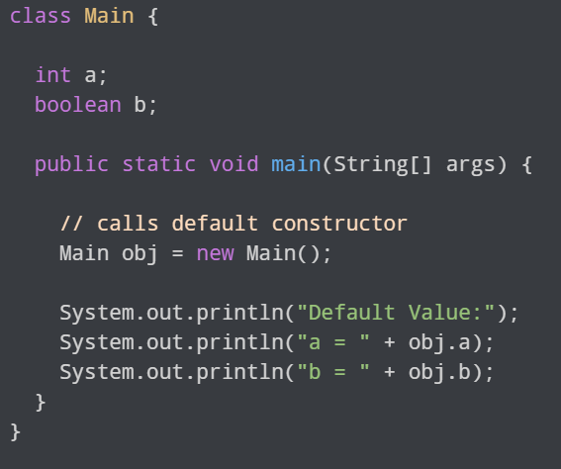
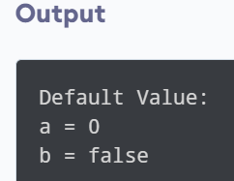
Constructor

Slide 51
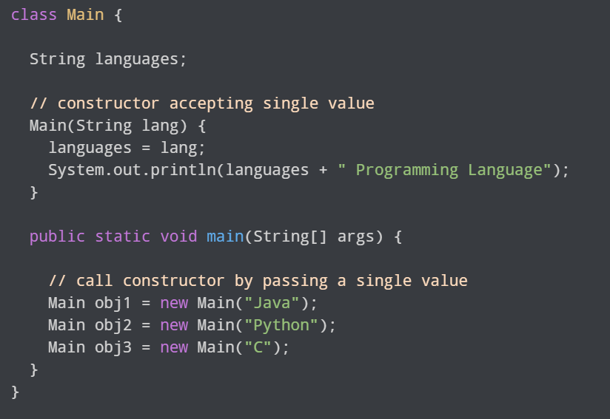
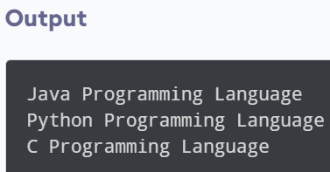
Constructor

Slide 52
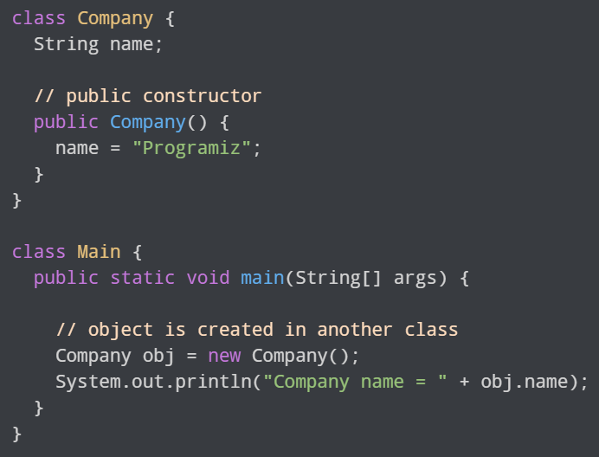
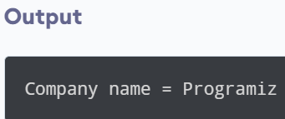
Constructor

Slide 53
Constructor initializes an object automatically at the time of creation and ensures a valid initial state. A normal method requires explicit invocation and may leave the object partially initialized if not called.

Slide 54
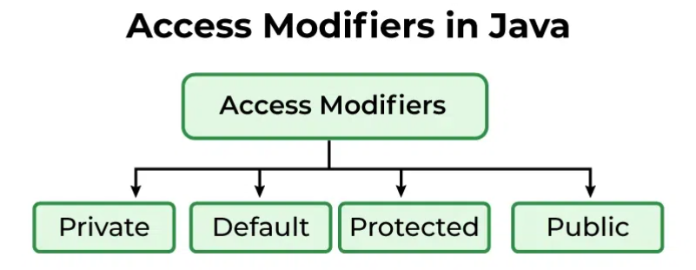
9. Java Access Modifiers
modifiers are essential tools that define how the members of a class, like variables, methods, and even the class itself, can be accessed from other parts of our program.

Slide 55
Private Access Modifier
The methods or data members declared as private are accessible only within the class in which they are declared.
https://onlinegdb.com/upIsVmTTT

Slide 56
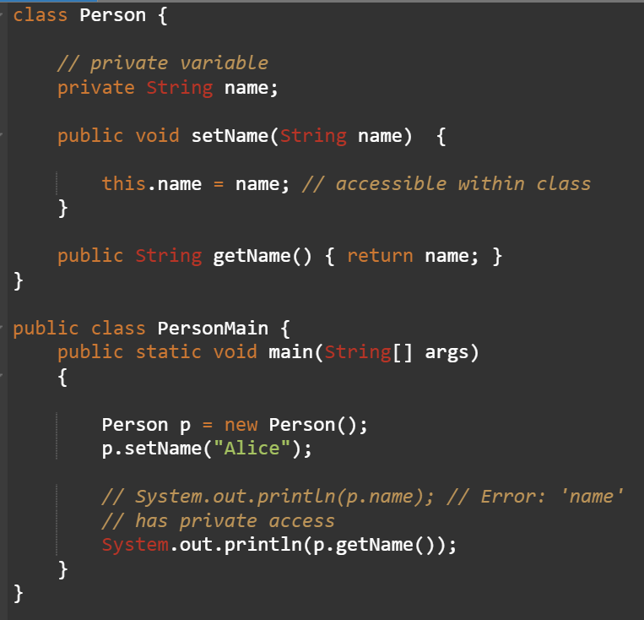

Slide 57
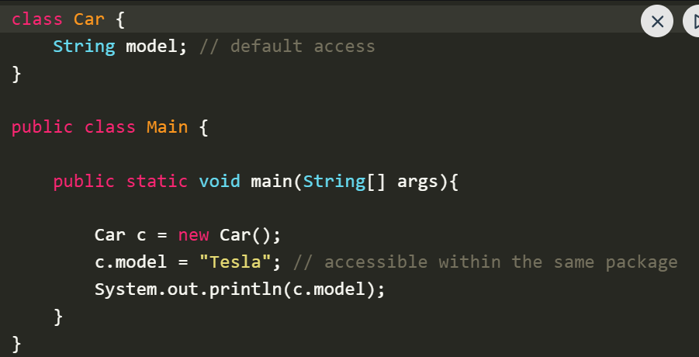
Default Access Modifier
When no access modifier is specified for a class, method, or data member, it is said to have the default access modifier by default. This means only classes within the same package can access it.

Slide 58
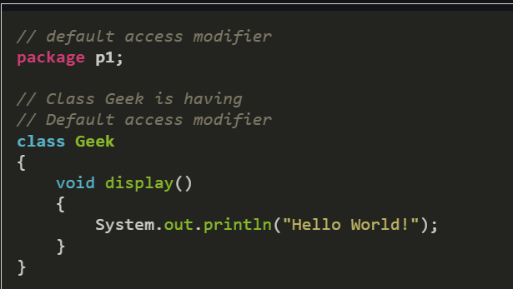
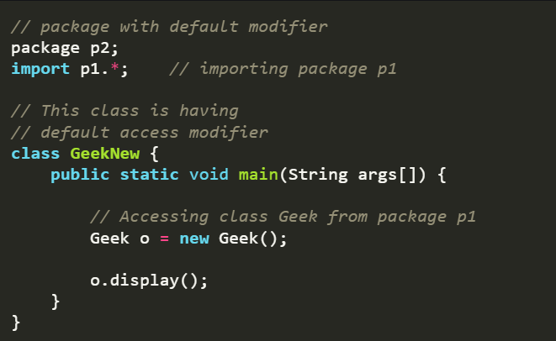
Notes:
In this example, the program will show the compile-time error when we try to access a default modifier class from a different package.

Slide 59
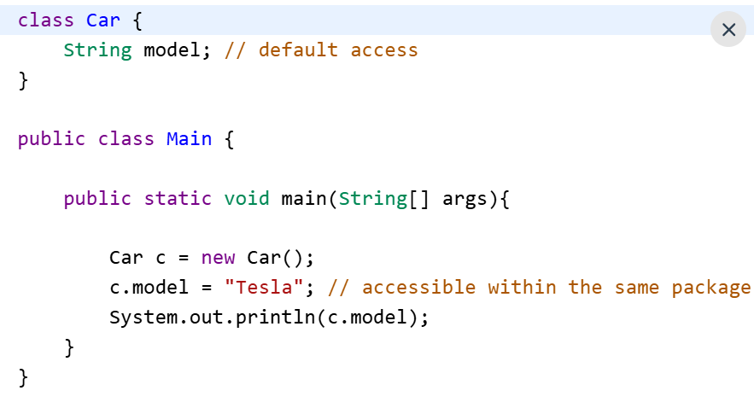
Public Access Modifier
The public access modifier is specified using the keyword public. Public members are accessible from everywhere in the program. There is no restriction on the scope of public data members.
Example 1

Slide 60
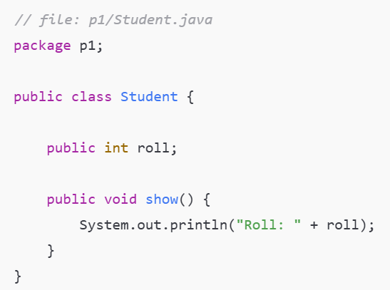
Public Access Modifier
Example 2
To access a public member from another package:
The class must be public
The member must be public
The package must be imported (or fully qualified name used)

Slide 61
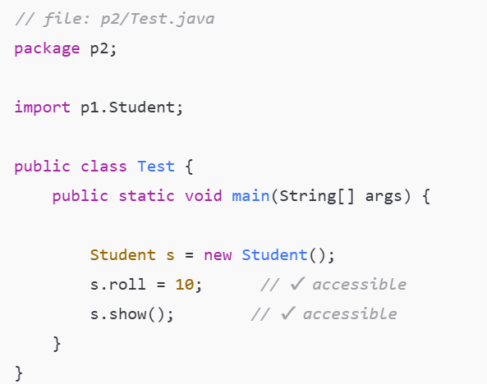

Slide 62
Protected Access Modifier
The methods or data members declared as protected are accessible within the same package or subclasses in different packages.
Example for this will be explained in inheritance topic.

Slide 63
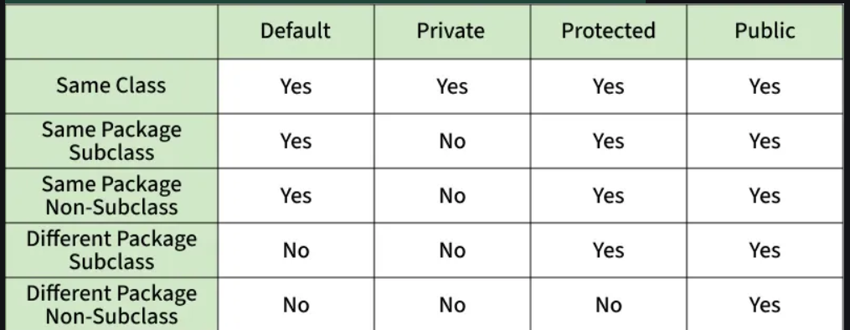
Comparison Table of Access Modifiers in Java

Slide 64
4. Encapsulation and information hiding
Encapsulation protects the data from corruption
It provides an interface to each object in such a way as to reveal as little as possible about inner workings.
It provides protection mechanism by using access specifiers such as public, protected and private.
Data are abstracted when they are shielded or hided by a full set of methods and only those methods can access the data portion of an object. E.g., A car engine.
3
Notes:
Hi

Slide 65
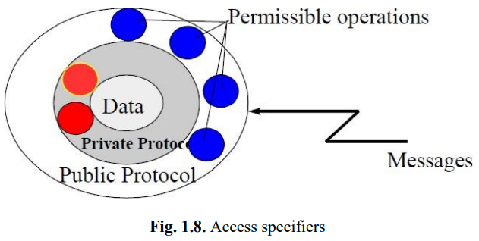
4. Encapsulation and information hiding
Information hiding is the principle of hiding internal data and procedures of an object
3
Notes:
Hi

Slide 66
4. Encapsulation and information hiding
Encapsulation protects the data from corruption
It provides an interface to each object in such a way as to reveal as little as possible about inner workings.
It provides protection mechanism by using access specifiers such as public, protected and private.
Data are abstracted when they are shielded or hided by a full set of methods and only those methods can access the data portion of an object. E.g., A car engine.
3
Notes:
Hi

Slide 67
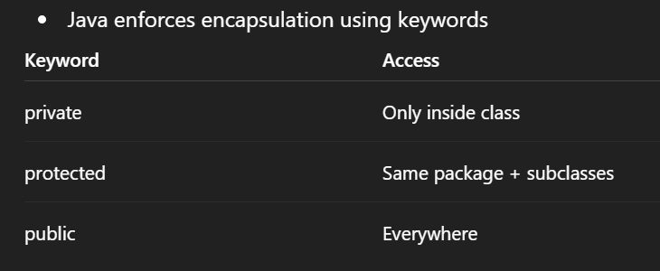
4. Encapsulation and information hiding
class Account {
private double balance;
}
3
Notes:
Hi

